Slide 1
Oracle HCM
Quest Group – Proposal

Slide 2

Employee from Hiring To Firing(Life Cycle)
Agenda
Quest Group Background
Why Oracle not other applications
User and Responsibilities
Business Group
Work Structure
Employees in Oracle
Assign the Payroll

Slide 3
Quest Company Services
Customized HR Solutions
Recruitment Process
Medical and Social Insurance
Cost Efficiency
Expert Team 12 hours/6 days Support
risk management
Employee Development and retention
Technology-driven HR solutions

Slide 4
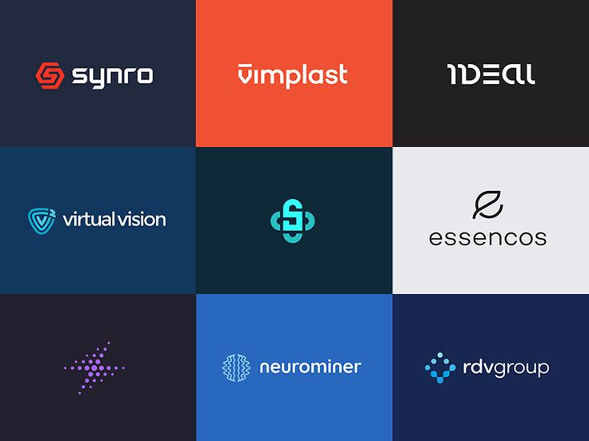
Quest Group Portfolio

Slide 5

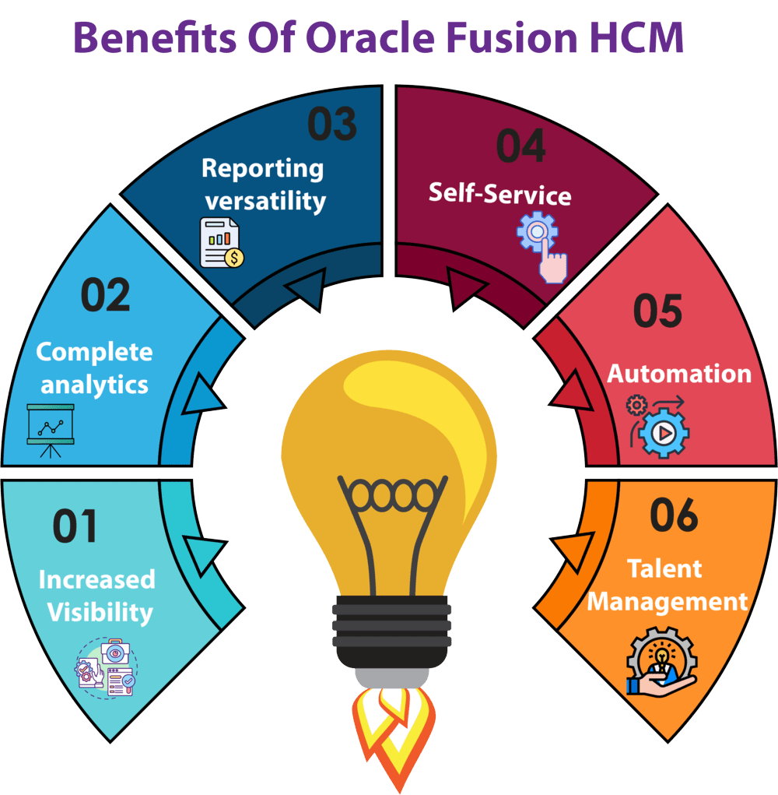

Slide 6
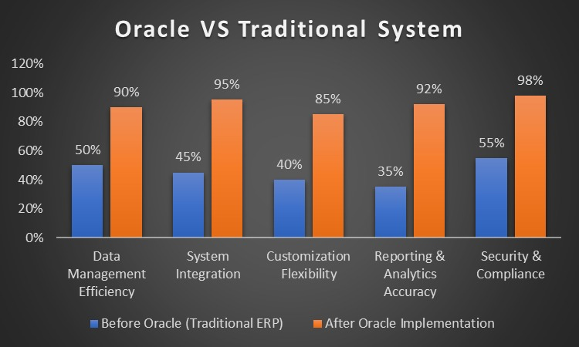

Slide 7
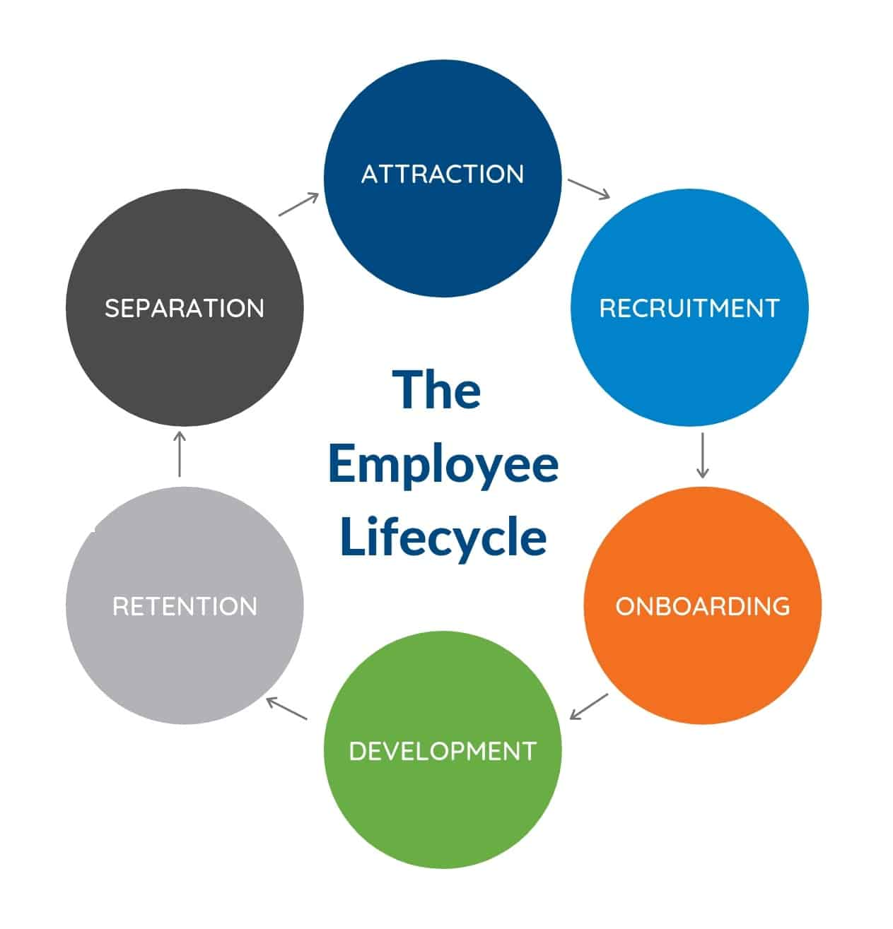

Slide 8

Creating user& responsibility

Slide 9
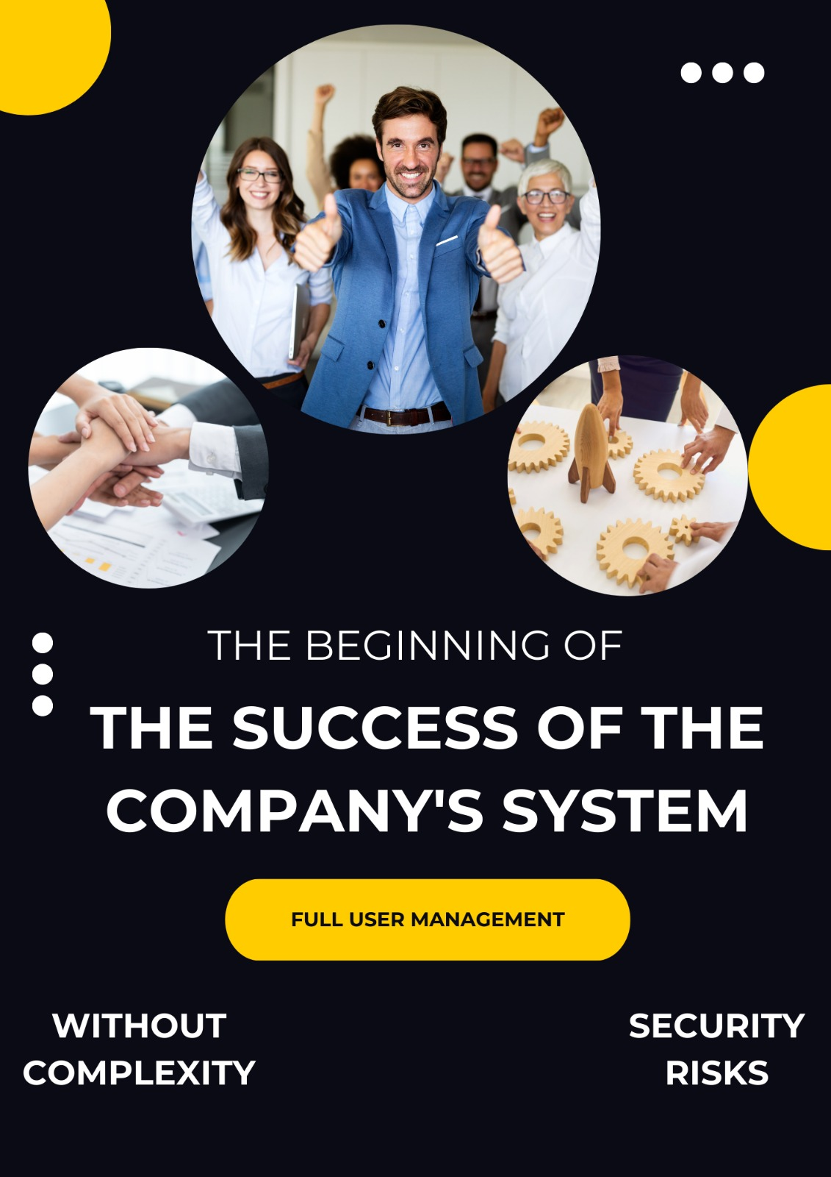

Slide 10
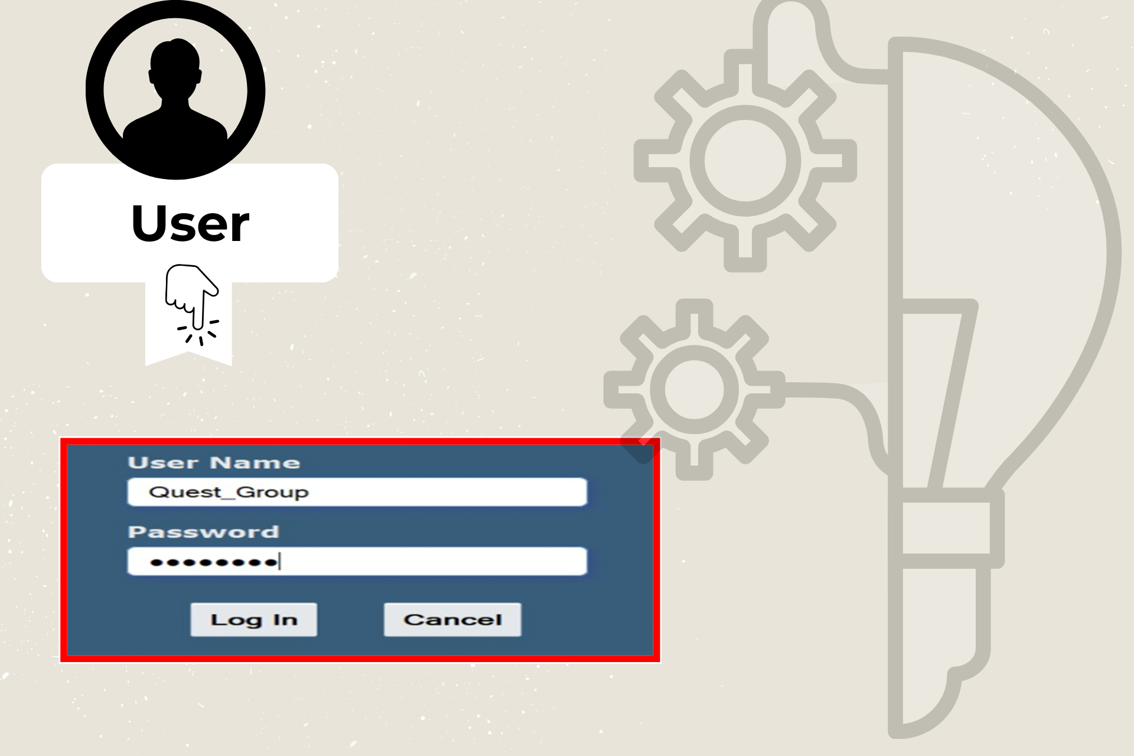

Slide 11
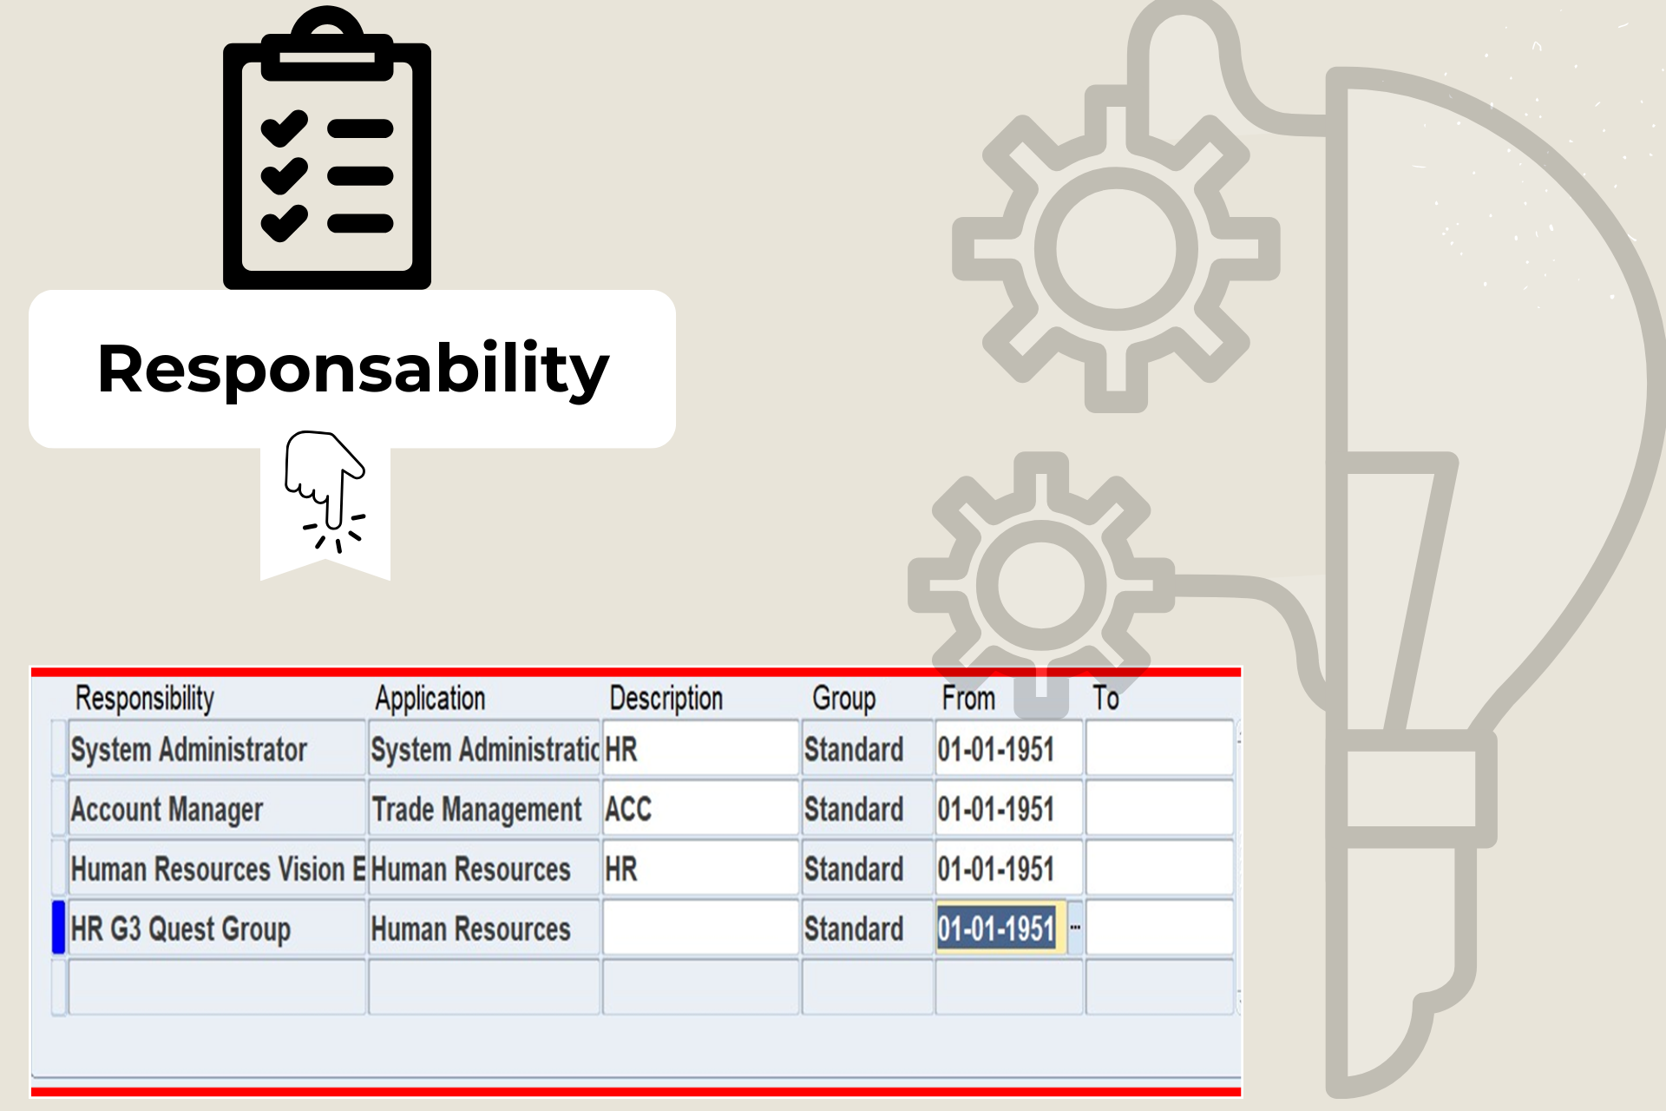

Slide 12
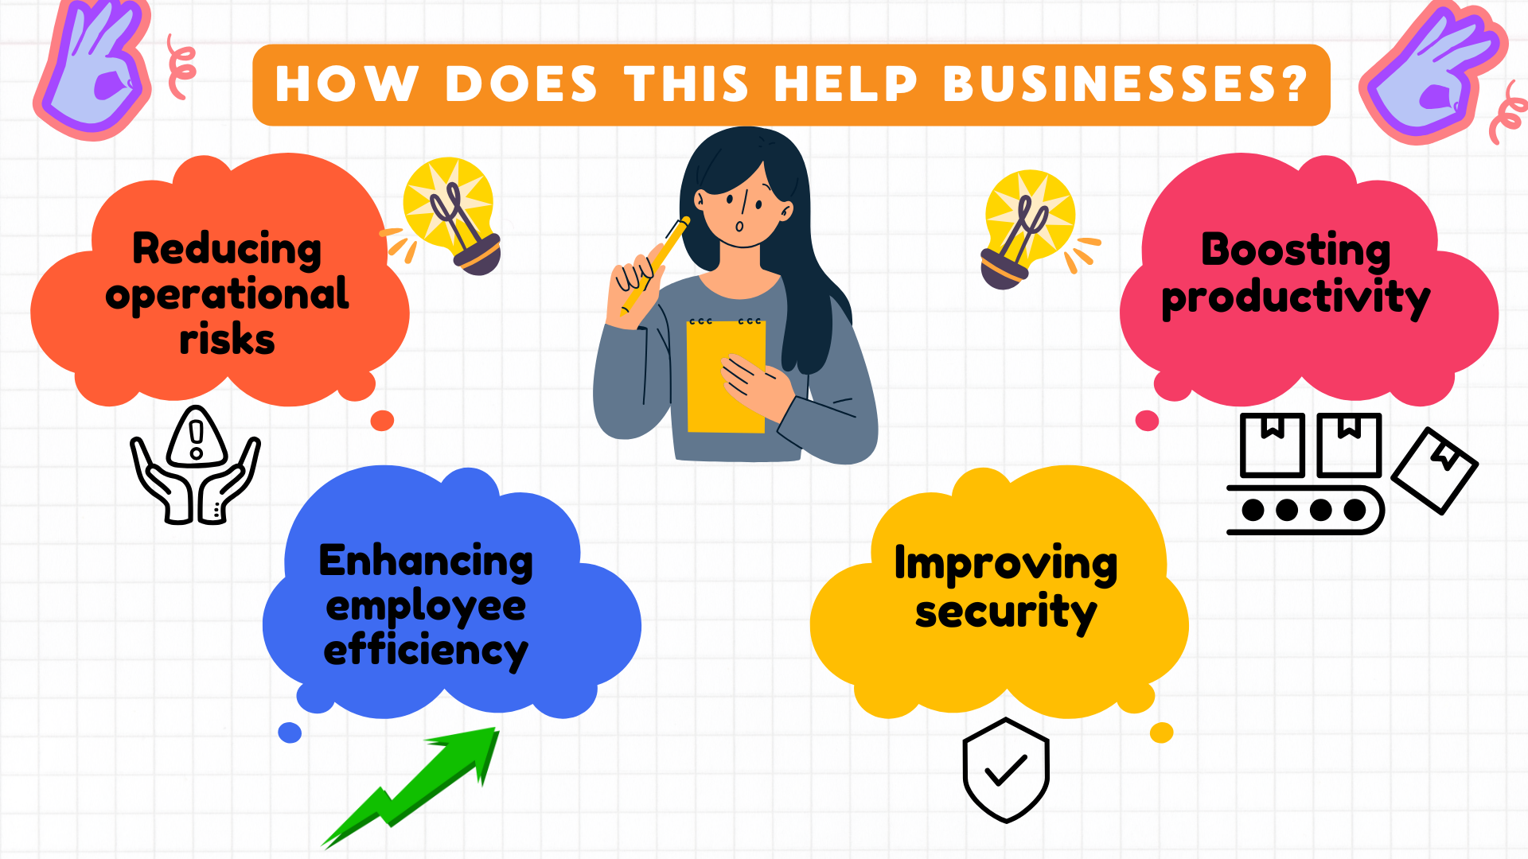

Slide 13

Creating Business Group

Slide 14
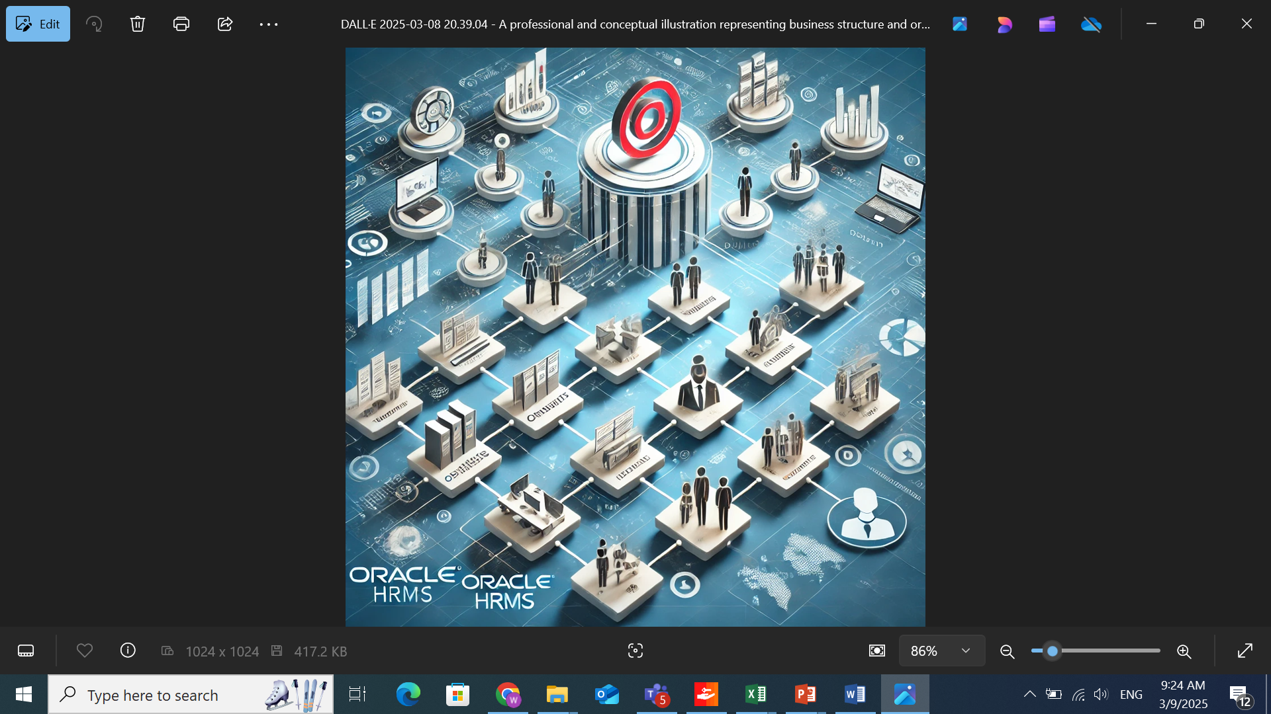
What is a Business Group?
It is a top-level structure representing a company or multiple companies
Why Is it important?
Helps structure and manage organizations efficiently.
Enables better data security and access control.
Supports multiple legal entities.
Allows customized HR policies

Slide 15
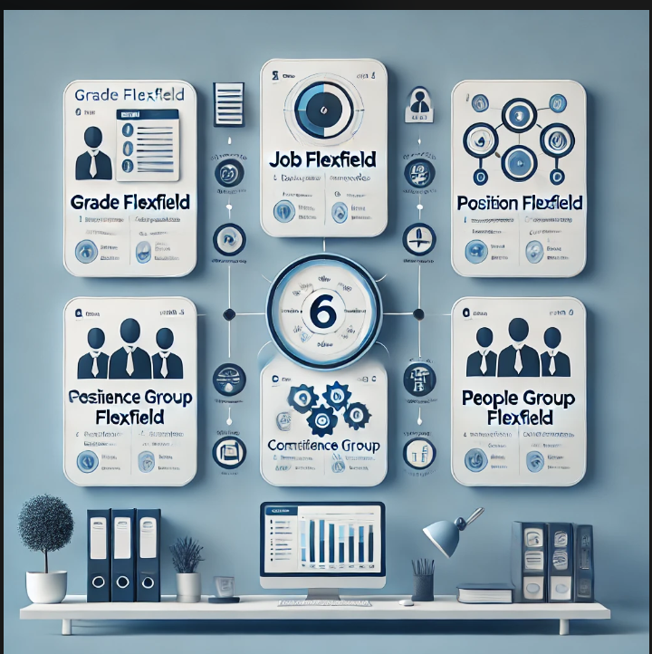
The Power of Oracle’s 6 Key Flex fields in Business Group
Oracle ERP provides six powerful Key Felxfields (KFFs) that give businesses ultimate flexibility in structuring their HR data.
1-Job Flexfield
2-Position Flexfield
3-Grade Flexfield
4-People Group Flexfield
5-Cost Allocation Flexfield
6-Competence Flexfield

Slide 16
Creating the Organization in the Structure
In Oracle HRMS, creating an organization follows a structured process to ensure accurate data management. The key steps include:
Business Group
Legal Entity
Operating Units and Departments

Slide 17
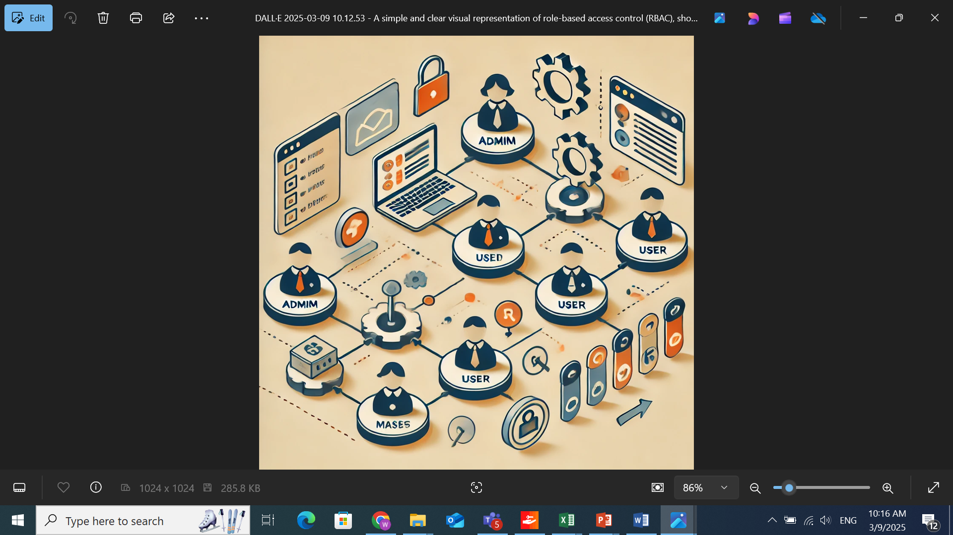
Linking the Organization to Responsibility
Ensures users have the right access based on their roles.
Strengthens security by restricting access to specific organizational data.
Helps streamline operations by assigning responsibilities correctly.

Slide 18
Comparison of Business Group in Oracle vs. Other ERP Systems
Aspect | Oracle ERP (Business Group) | Other ERP Systems
Flexibility | Allows defining HR policies separately for each Business Group. | Often requires additional customization to achieve similar flexibility.
Multi-Organization | Supports a Multi-Org environment with independent setups. | Some systems offer similar support but with less flexibility.
HR Integration | Fully integrated with HR applications like Absence Management and Payroll. | Integration varies and may require extra configurations.

Slide 19

Work Structure

Slide 20


Slide 21
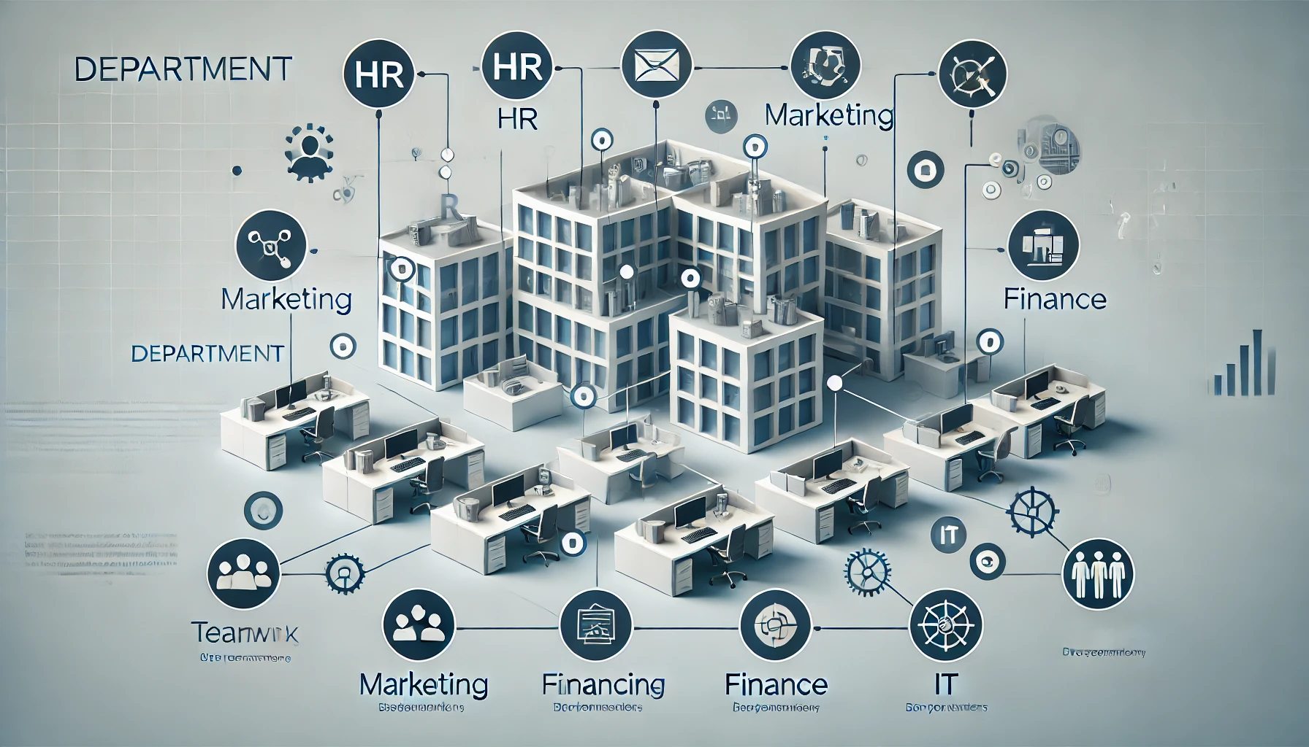

Slide 22
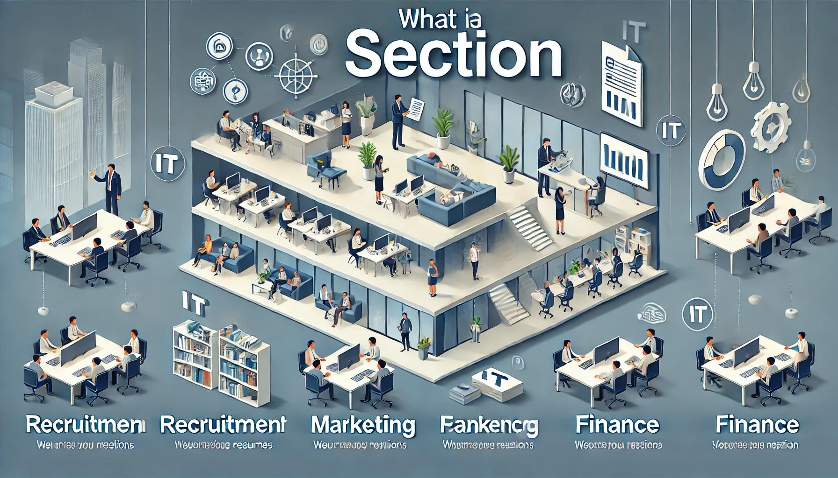

Slide 23


Slide 24

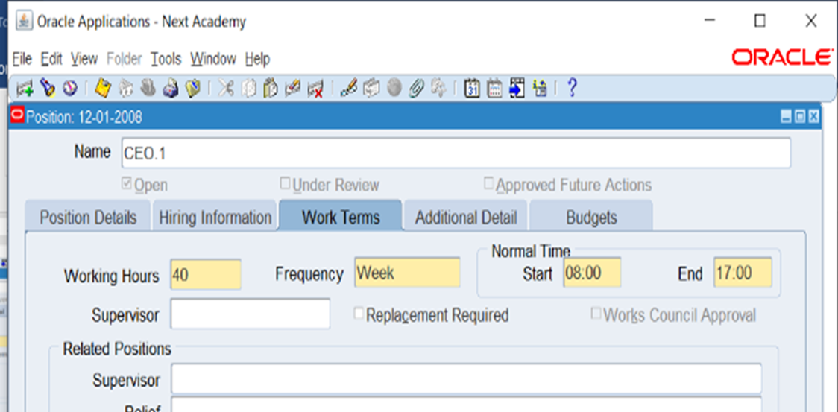

Slide 25
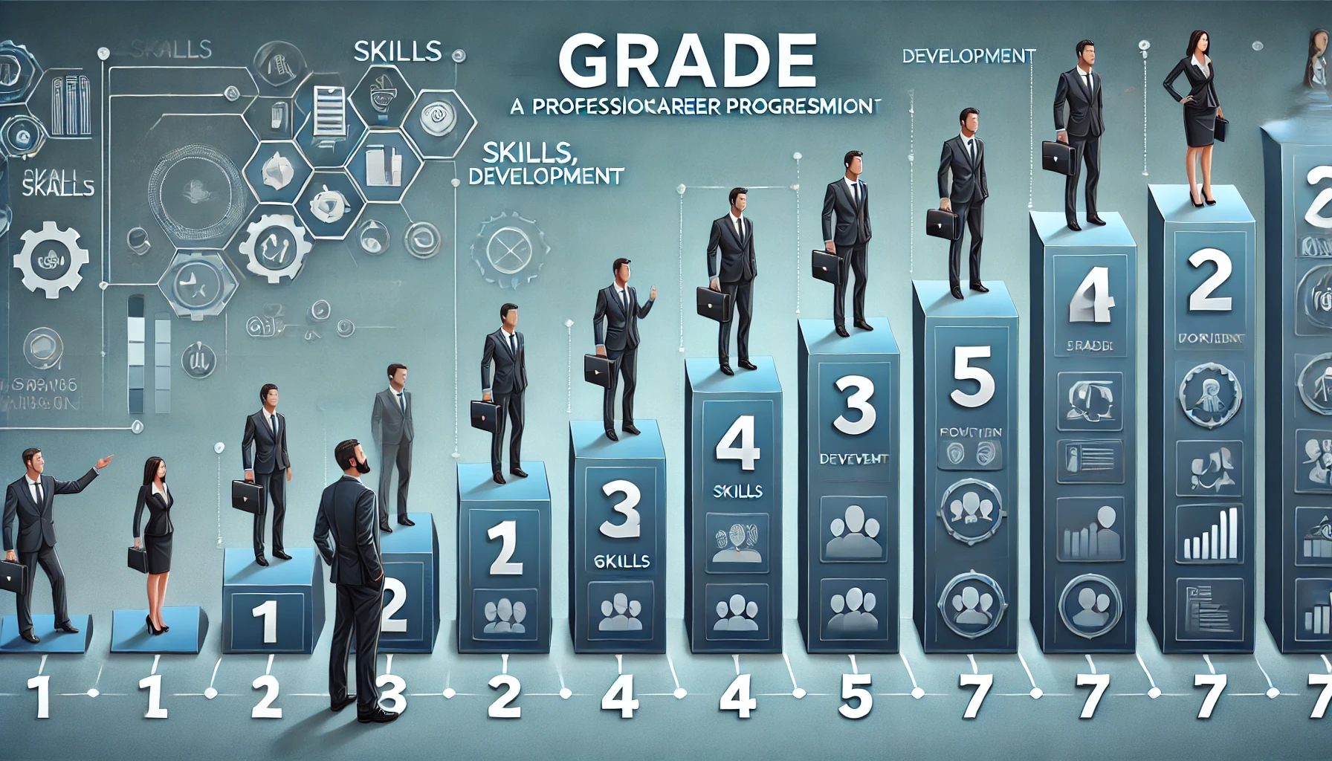
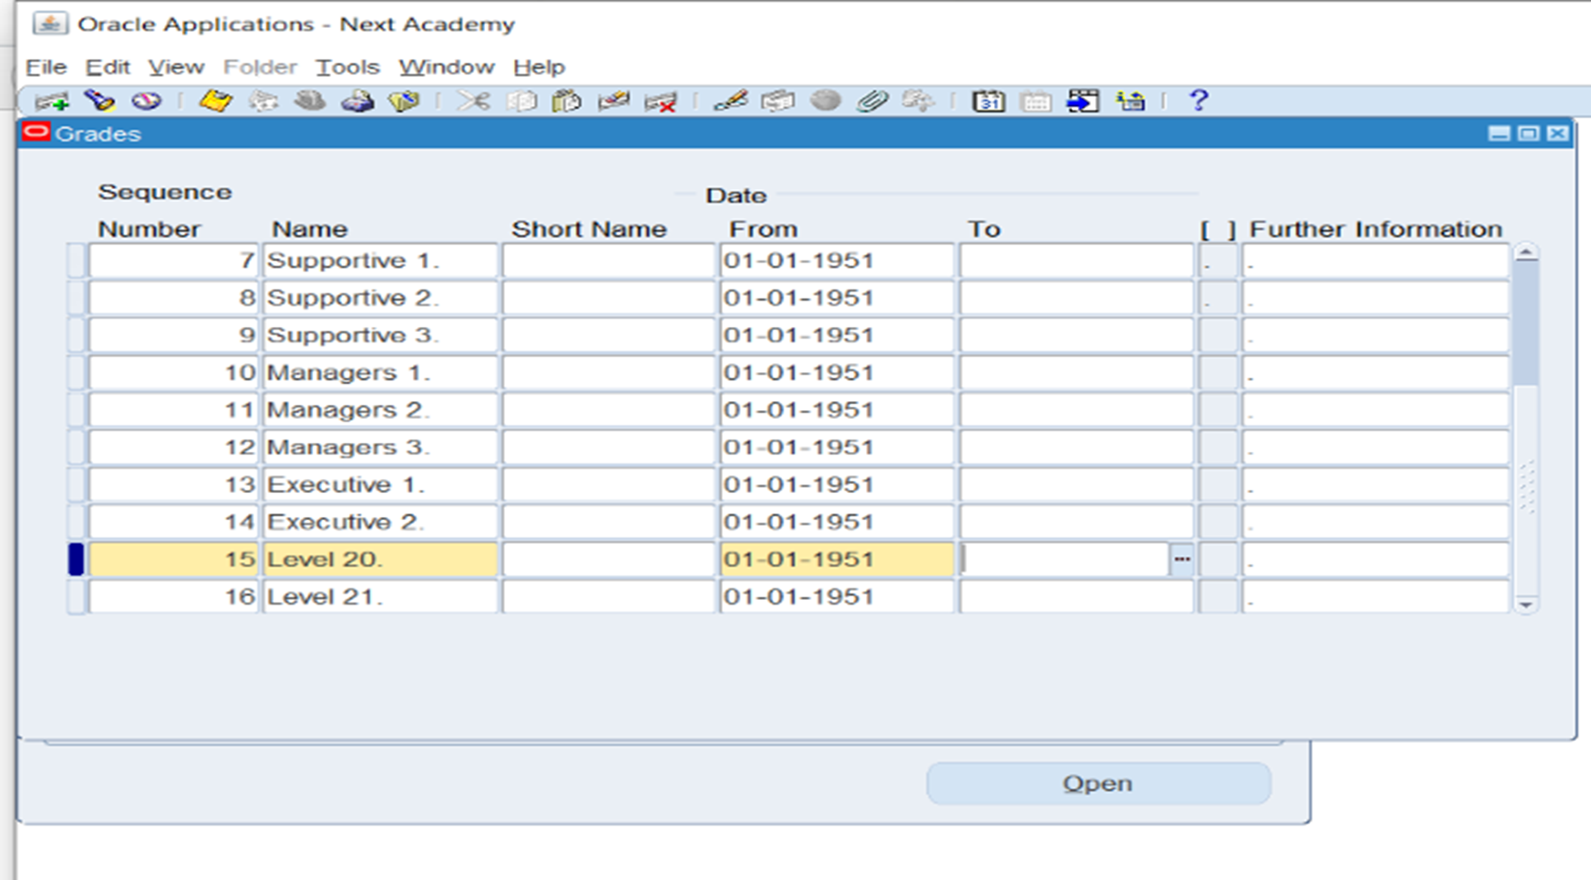

Slide 26

Diagrammer

